Slide 1
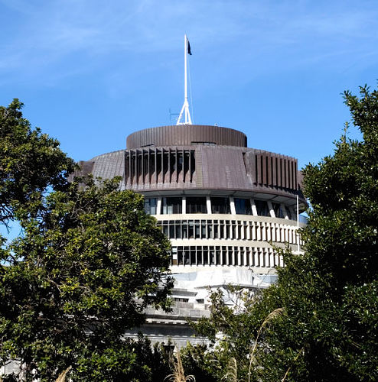
... is the popular name for the Executive Wing of the parliamentary complex because of the building’s shape (NZ)
The ‘Beehive’

Slide 2
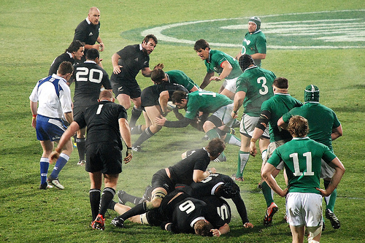
The national rugby team of New Zealand
All Blacks

Slide 3
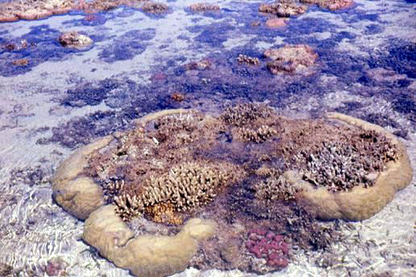
A 1,250 mile (1,012 km) long coral reef off Australia's northeast coast
Great Barrier Reef

Slide 4
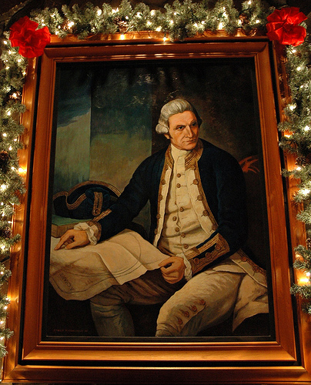
The first explorer to reach Australia and claim it for Great Britain in 1770
Captain James Cook

Slide 5
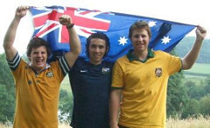
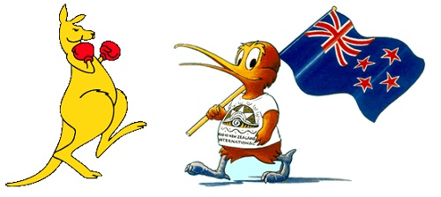
Australians and New Zealanders
Aussies and Kiwis

Slide 6
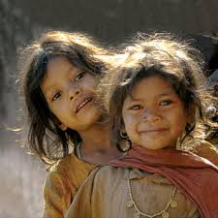
The lowest level of Indian society; not considered a real part of the caste system; often given degrading jobs; their life was extremely difficult
Untouchables

Slide 7
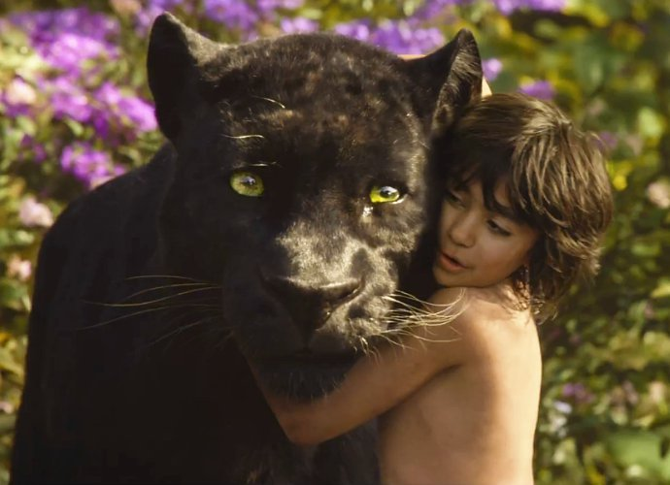
The author of “The Jungle Book“?
Rudyard Kipling

Slide 8
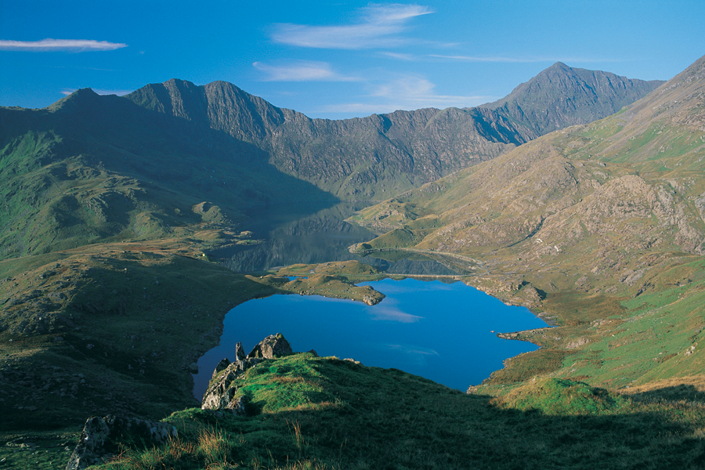
Which Welsh mountain is the only mountain in the world to have a national park named after it?
Mount Snowdon

Slide 9
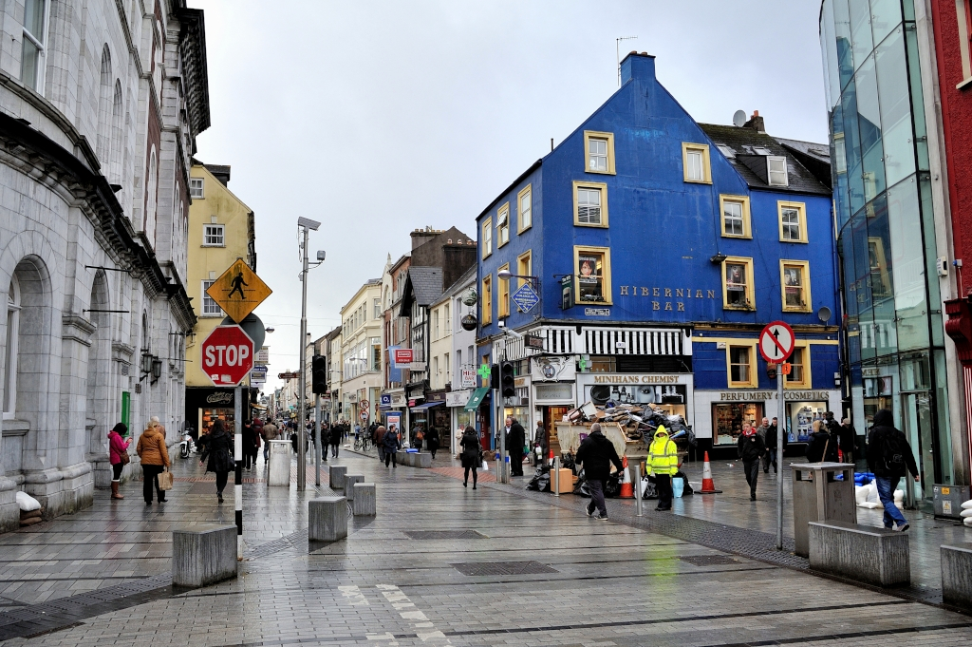
Which Irish town sounds like something in a wine bottle neck?
Cork

Slide 10
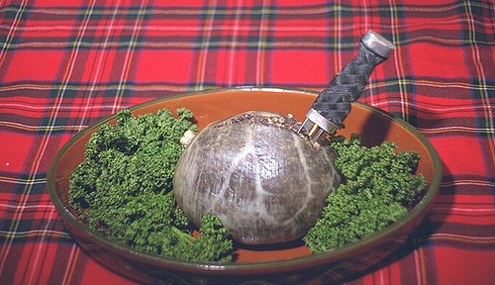
Scotland’s National Dish
Haggis

Slide 11
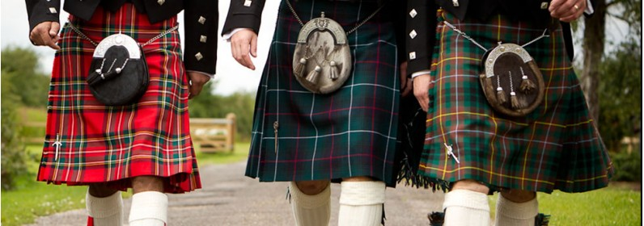
A short, pleated skirt, worn by men in the Scottish Highlands
A Kilt

Slide 12
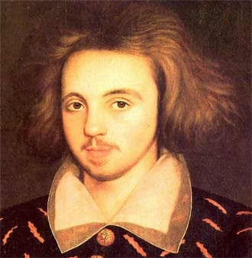
“To do a great right do a little wrong.“
William Shakespeare

Slide 13
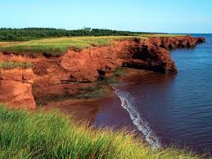
The smallest province in Canada is
Prince Edward Island

Slide 14
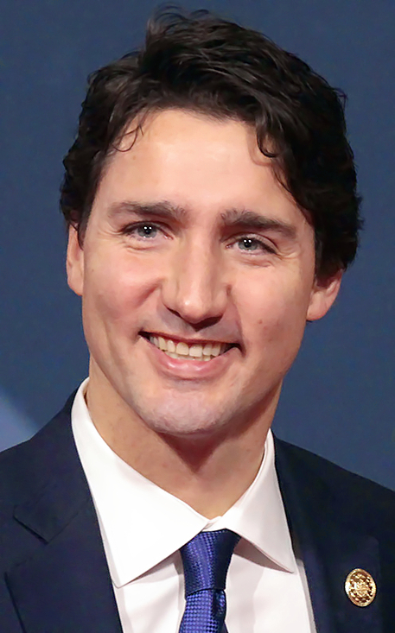
The leader of Canada is known as the
Prime Minister

Slide 15
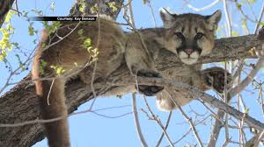
An animal native to Canada
A Cougar

Slide 16
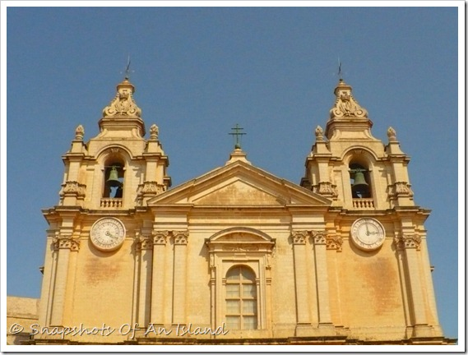
The famous church in Mdina, St Paul's co-Cathedral, has 2 clock faces with different times on. Why is this?
It's there to confuse the Devil

Slide 17
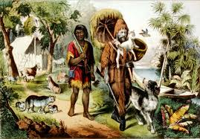
The first Royal Governor of the Bahamas, Woodes Rogers, was also a privateer and English sea captain. He has a connection with a famous literary character. Which character is it?
Robinson Crusoe

Slide 18
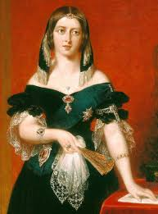
The capital city of Nassau boasts many historic sites, among them a staircase of 65 steps cut into solid rock, called The Queen's Staircase. For which queen is this monument named?
Queen Victoria

Slide 19
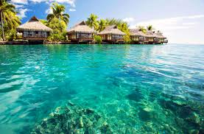
Where in the world would you locate the Bahamas?
Off the east coast of Florida

Slide 20
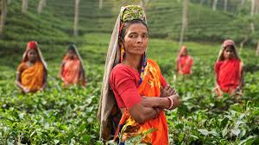
What did Bangladesh become known as after its first session of Independence in 1947?
East Pakistan

Slide 21
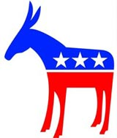
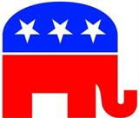
What are the two major parties in the US?
The Republicans and the Democrats

Slide 22
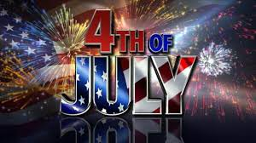
What do Americans celebrate on July 4th?
Independence Day

Slide 23
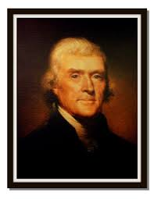
Who said: 'We hold these truths to be self evident that all men are created equal'?
Thomas Jefferson

Slide 24
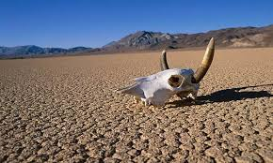
What is the hottest place in the USA?
Death Valley

Slide 25
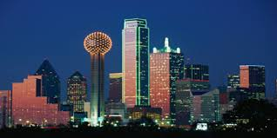
President John F Kennedy was assassinated in ...
Dallas, Texas

Slide 26
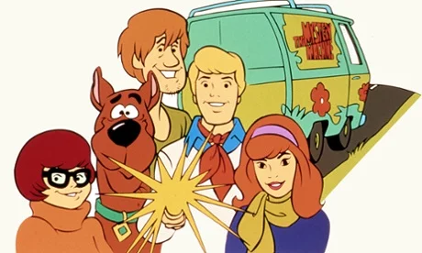
Where would you eat a "scooby snack"?
Glasgow

Slide 27
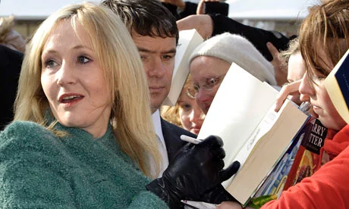
In which city does Harry Potter author JK Rowling reside?
Edinburgh

Slide 28
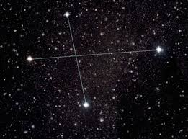
What constellation features on New Zealand's flag?
The Southern Cross

Slide 29
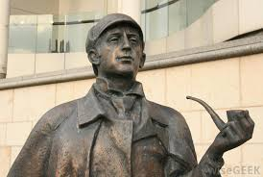
Which fictional character lives at 221B Baker Street, in London?
Sherlock Holmes

Slide 30
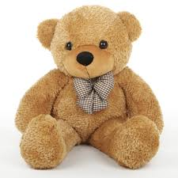
Which former American President had a popular children's toy named after him?
Theodore Roosevelt.

